Slide 1
IT & Cyber Security Commercial Certifications
A Way to Enhance Your Professional Career and Add Value to Your Degree

Slide 2
Agenda
What are Certifications
Pros and Cons
Popular Certifications and Certifiers
Paths to Certification
CPEs and Strategies

Slide 3
What are IT/Cyber SecurityCommercial Certifications?
Commercial certifications are endorsements by third parties, that validate a person’s knowledge, skill, or both in/on a field or platform. Attaining a certification is normally obtained by passing an exam, normally with a cost.
Certifications are a quick and powerful way of gaining entry into the job market. This has been driven by the government and requirement of commercial certifications for certain jobs.
Exams for certifications tend to either be:
Passive: Test is comprised of questions on body of knowledge
Functional: Test is comprised of a series of simulations
Hybrid: Test has both

Slide 4
Background/How and Why I became certified
Joseph Gray
2001, BS, Public Management PSU
2002 City Clerk of Rochester, 2005 Certified Municipal Clerk (CMC)
2002 Joined the National Guard, 2010 Security+, CompTIA, 2010 (Lifetime)
2012 FA53, CCNA, CMSA, CISSP 437309, ISC2
2013 Cyber Protection Team, Certified Ethical Hacker (CEH), EC Council, 2013, 2018
2022, Joined UNH GIAC Security Leadership (GSLC), GIAC,
President of the Concord/Lexington ISC2 Chapter

Slide 5
Pros and Cons of Certifications
Pros:
Is a great way to separate yourself
Can normally be prepped through a boot camp
Can demonstrate practical knowledge
Provides an employer with a way to validate a candidate’s credentials
Provides an employer with a third party verification of skill
Can visually enhance resume and communications with digital badges, that are certfiable
Cons:
Tests can be extremely hard
Tests can be expensive
Committing self to a lifetime of Continuing Professional Education (CPE)
The Certifier can do things to devalue the certification

Slide 6
Certifiers
Bodies normally made up of a board of directors or executive council. The voting body is normally its members.
Goals include:
Directed towards certain technologies and concepts
Upholding and promoting best practices and accepted standards
Demonstrating value of certification to best practices
Creating and supporting education leading to certification
Keeping certification relevant through CPE Requirements
Ensuring certifications are accepted by other governing bodies
Collect Dues
Try to create a tiered approach to certifications, most vendors were originally known for one cert
Notes:
https://dl.dod.cyber.mil/wp-content/uploads/8140/pdf/unclass-dod8570_ia_program_transition_dod8140_cwp.pdf

Slide 7
Certifier Considerations
Certifier is normally known for one certification
Certifier then tries to create a series of certs to support their key certification
Certifiers look around and try to emulate competing certificates
Certifiers talk to the industry and incorporate standards and requirements into their certifications
Certifiers require continuing education to maintain the cert, how hard is the cert to maintain?
Notes:
https://dl.dod.cyber.mil/wp-content/uploads/8140/pdf/unclass-dod8570_ia_program_transition_dod8140_cwp.pdf

Slide 8
Government Driven Certification
The Federal government has driven certifications by requiring IT staff have a commercial certification. Up until 2023 DoD directive 8570 dictated what certifications were needed by work role. In 2024 8140 took over complicating the process by adding more work roles but entrenching IT certifications even more.

Slide 9
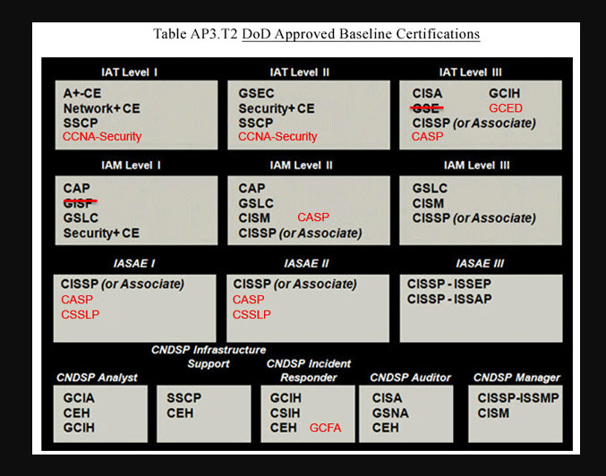
8570
Notes:
https://www.avuedigitalservices.com/casting/aisearch/control/cyberWorkforceProviderMarketPlace

Slide 10
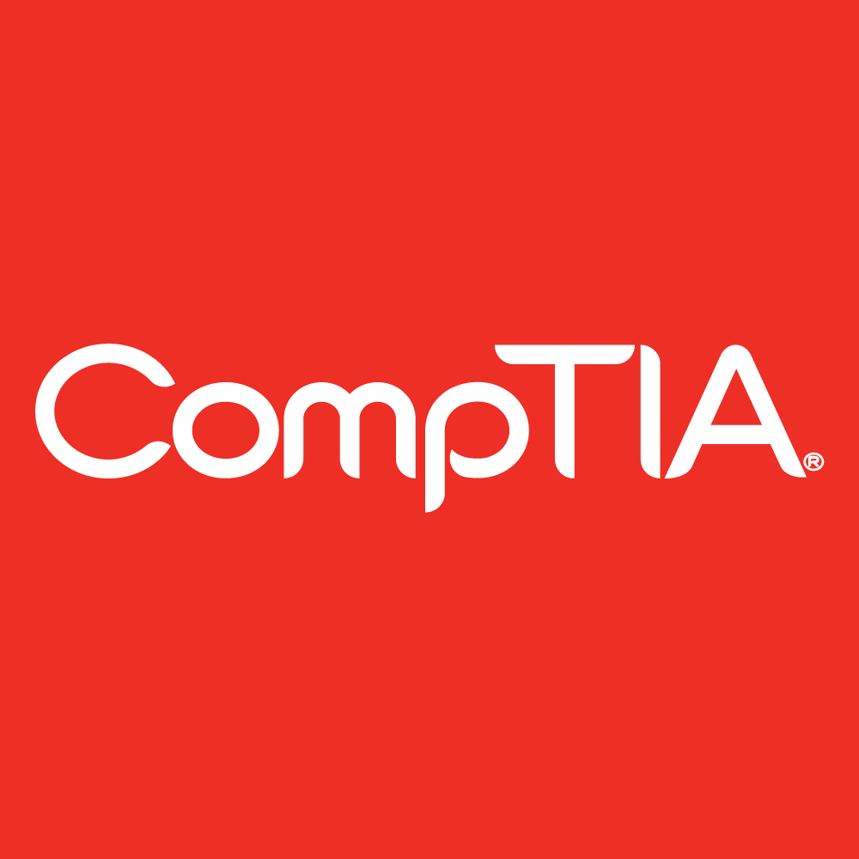
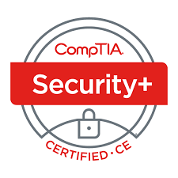
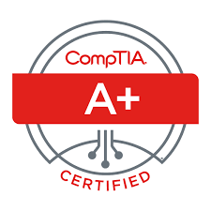
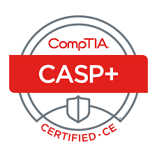
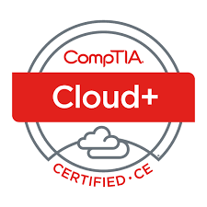
Certifiers
CompTIA
17+ Certifications, best known for entry level certifications A+ and Security+. Originally certification was for lifetime until government wanted some kind of continuing education requirement.
Tests were originally passive, but have grown more hybrid with a hands on portion. Tests are expensive at just over $400

Slide 11
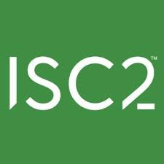
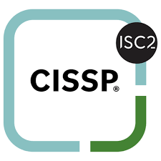
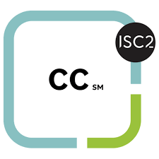
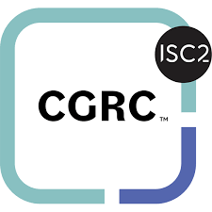
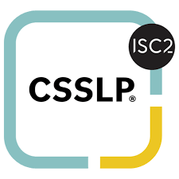
Certifiers
ISC2
9 Certifications, best known for the senior level certifications CISSP, requires passing a test and 10+ years of experience. ISC2 certifications are primarily management and policy certifications. ISC2 is trying to make their certs more skill based. CISSP is considered a gold standard in certifications.
Tests are passive/adaptive with follow up questions on ones the subject got wrong. Test costs range from $199-$749. ISC2 offers a free CC training kit and test voucher.

Slide 12
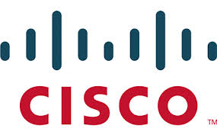
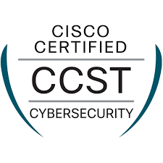
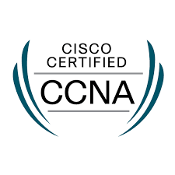
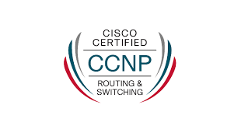
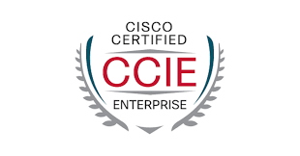
Certifiers
Cisco
4+ Certifications, best known for the mid-level networking certification CCNA and their robust education system, CISCO Academy. Cisco has recently changed their certification system adding concentrations to their certs (Making it confusing). CCNA is considered one of the best baseline networking certs.
Tests are hybrid with networking simulations. Packet tracer is a free sim that you can download and train on. Test costs range from $125-$400.

Slide 13
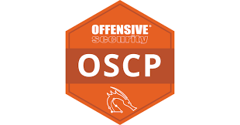
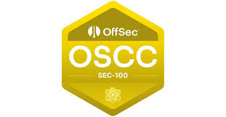
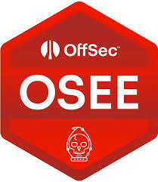
Certifiers
OffSec
12+ Certifications, best known for Offensive Security Certified Professional (OSCP), a skill driven test, that few can pass. OffSec certs are primarily from security through penetration test perspective. All OffSec training is self-paced. There are training partners but bootcamps are very expensive. Average OSCP Salary is $119,000
Tests are hands on with OSCP giving 24hrs to hack 6 systems. Cost for the course and 1 Test is $1600, retests are costs range from $125-$400.

Slide 14
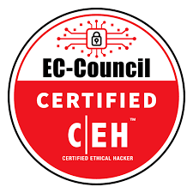
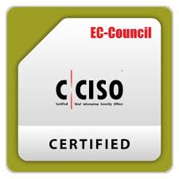
Certifiers
EC Council
15+ Certifications, best known for Certified Ethical Hacker (CEH). The strength of the EC Council certs, is their naming convention, which allow for not IT people to understand the certification. bootcamps are very expensive. Average OSCP Salary is $119,000. They have recently complicated their certs by adding concentrations. They offer their own degree.
Tests are hybrid. Cost for tests run from $99-$699.

Slide 15
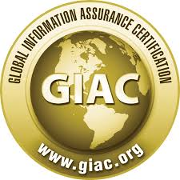
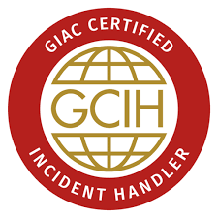
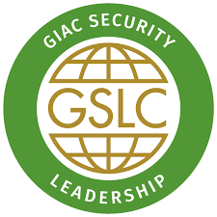
Certifiers
GIAC (SANS)
40+ Cyber Security Certifications, best known for GIAC Certified GSE. Normally initial tests are packaged with training which is expensive $5,000-$12,000. Tests are extremely difficult even though they are open book. GIAC offers people who pass the test with a 90 or higher are allowed to teach the course after a mentorship program.
GIAC offers a Cyber Security Masters Degree for $54K and prior certs do not apply. The military has built jobs entirely off of these certifications.

Slide 16
Should I get Certified? Strategies
What do you want to demonstrate through the certificate?
What jobs do you want?
How does the certifier manage themselves? what is the long-range goals? do they align with what you are looking for in a certifier?
What are the requirements to maintain the cert?
O’Reilly Books, https://www.oreilly.com/
A lot of certifiers offer entry level certs, ISC2 (CC)
CPEs through new certificate bootcamp

Slide 17
Questions
Questions

